Slide 1
REGIONAL DISBURSING OFFICE – WEST
PERMANENT DUTY TRAVEL
LAST UPDATED: NOV 2017

Slide 2
CURRICULUM OVERVIEW
Common PCS Entitlements
Entitlements Not Paid with Travel Claim
TLE
DLA
Modes of Travel
OCONUS Travel
Circuitous Travel
Completing Your Travel Voucher (1351-2)
Useful Information
References / Points of Contact

Slide 3
COMMON PCS ENTITLEMENTS
What is Per Diem?
Daily amount paid to a traveler on official business which covers lodging, meals, and incidentals.
Commercial transportation per diem is based on the locality rate.
POV per diem is $144 per travel day. (changes every FY)
What is MALT (Monetary Allowance in Lieu of Transportation) ?
Amount paid to traveler to reimburse mbr for mileage used during travel.
Current MALT rate: $0.17 per mile (changes every CY)
Distance is calculated by DTOD (Defense Table of Official Distances)
MALT can be paid up to (2) POVS if mbr states (2) POVs were utilized on 1351-2.
MALT is not based on the number of travelers.
How is travel time/distance calculated?
Travel days are calculated by using (350) miles / per (1) day based on the DTOD distance from old PDS to new PDS.
If the excess distance is (51) miles or more after dividing distance by (350), (1) additional travel day is allowed.
There is no mandatory distance that must be driven per day.

Slide 4
COMMON PCS ENTITLEMENTS
What expenses are reimbursable during PCS moves?
Tolls
Commercial transportation expenses (bus, airfare, taxi)
Lodging
Moving expenses
Receipts for any expense costing $75.00 or more must be provided
All expenses MUST be annotated on 1351-2 in block 18
What expenses are not reimbursable during PCS moves?
Food
Gas
Rental vehicles
Any expense $75.00 or more without a valid receipt
What are the requirements for receipts?
Legibly written/printed
Name of vendor
Date the good/service was provided/purchased
Price of the good/service purchased
Total amount due
Indication that the total amount due was paid
Include bank statement showing expense was purchased to prevent issues

Slide 5
ENTITLEMENTS NOT PAID ON TRAVEL CLAIM
TLA (Temporary Lodging Allowance)
Used to partially reimburse a mbr for expenses obtained while using OCONUS temporary lodging facilities.
TLA is a pay entitlement and will not be reimbursed on your travel claim. Contact the Pay section within disbursing for further information.
HHG (House Hold Goods Shipment)
Relocation of mbrs house hold items from one PDS to the other.
Normally authorized up to 18,000 pounds, but varies by grade & dependency status.
For information regarding HHG shipments, please contact DMO.

Slide 6
TEMPORARY LODGING EXPENSES (TLE)
What is TLE?
Reimbursable expense used to partially reimburse a mbr for lodging and meal expenses obtained while using temporary lodging in the continental United States.
Who can receive TLE?
Mbrs who do not reside in government quarters.
Mbrs who do not have government quarters available.
When is TLE not authorized?
For a house hunting trip taken before the mbr moves to the new PDS.
For depns acquired after the effective date of orders (first travel day on last leg of travel).
On behalf of depns who returned from an OCONUS location prior to mbr receiving PCS orders.

Slide 7
TEMPORARY LODGING EXPENSES (TLE)
Where must lodging facilities be?
All mbrs are required to stay in government quarters.
Lodging facilities must be near old and/or new PDS.
For reimbursement of lodging off base, a statement of non-availability from the unit and/or housing facility must be included with travel claim or mbr will be limited to the govt quarters rate.
If mbr stays with friends/family, mbr can only be reimbursed per diem if annotated on 1351-2.
How do mbrs request reimbursement of TLE?
Provide all itemized lodging receipts and submit with travel claim.
Complete TLE worksheet to ensure all travelers are paid correctly.
List lodging expenses on 1351-2 in block 18. Include room and state taxes to the daily cost of lodging.

Slide 8
TEMPORARY LODGING EXPENSES (TLE)
What important information should mbrs know?
Cannot be paid on any day mbr is being paid per diem.
Limited to (10) days.
Days do not have to be consecutive and can be split among previous PDS, new PDS, and/or designated place, unless previous PDS is overseas.
Members married to members cannot receive travel and transportation allowance payments for the same expense.
Itinerary on 1351-2 must show traveler in the same area on the same dates lodging was utilized.
Pet fees are only reimbursable for military K9s which will be authorized in mbrs orders.
Travelers will be limited to the max amount of lodging cost ($290 per day) regardless of location, price paid, or number of depns.

Slide 9
DISLOCATION ALLOWANCE (DLA)
What is DLA?
Reimbursable expense used to partially reimburse a mbr for the expenses incurred when relocating their household for:
Permanent Change of Station
Government Convenience
Incident to an evacuation
When is DLA not authorized?
When the move is from your home or the place from which you entered active duty to your first permanent duty station unless your depns move.
For members without dependents assigned to Gov’t quarters at the new PDS.
What important information should mbrs know?
Mbrs must request payment of DLA on 1351-2.
DLA is paid under (2) different rates which vary by rank:
DLA with dependents
DLA without dependents
Only (1) payment of DLA is authorized per married couple. For special circumstances regarding mbrs who are married to mbrs of the armed forces, refer to the JTR, Chapter 5: Permanent Duty Travel, Part A: Mbrs Only, Sec 10: DLA.

Slide 10
MODES OF TRAVEL (POV)
What modes of travel can be used?
Depending on what is authorized in the mbrs orders, a mbr may elect to travel by:
- Personally owned vehicle (POV)
- Commercial transportation (ex: air, bus, rail)
- Transportation purchased by the government
What should a mbr expect when traveling by POV?
Mbr will receive $0.17 per mile traveled.
Travelers will be reimbursed travel per diem for each authorized travel day used which covers the cost of daily lodging and meals.
Mbr: $144.00
Depns 12 and over: $108.00
Depns 11 and under: $72.00
If depns travel on separate dates, the spouse or (1) depn driver will receive the full rate of $144.00
What if I am authorized (8) travel days from Camp Lejeune to Camp Pendleton, but check into new PDS in (4) days?
Travelers will be limited to actual travel days utilized meaning DTOD determined travel distance from Camp Lejeune to Camp Pendleton is 2,632 miles which allowed (8) travel days. If mbr checked into new PDS in (4) days, all travelers will only receive (4) days of travel per diem plus $447.44 for MALT.

Slide 11
MODES OF TRAVEL (COMMERICAL)
What should a mbr expect when traveling by commercial transportation?
Mbr will receive (1) day of commercial per diem regardless of how many travel days used.
Mbr may be reimbursed airfare if claimed on 1351-2 and provides a valid receipt.
Mbr will be limited to the GTR cost of the flight meaning if mbr purchased flight for $900, but the government could have purchased the flight for $750 then mbr will only receive $750.
To compare GTR costs visit:
https://cpsearch.fas.gsa.gov/cpsearch/search.do?method=enter
What should a mbr expect when traveling by transportation purchased by the government?
Mbr may receive up to (2) days of commercial per diem depending on how many travel days mbr used.
Mbr will not be reimbursed airfare.
Where do I find the rates for commercial per diem?
https://www.defensetravel.dod.mil/site/perdiemCalc.cfm
You will only receive 75% of commercial per diem on the day of departure from the old PDS and the day of arrival to the new PDS.

Slide 12
MODES OF TRAVEL (MIXED)
What if I use more than one mode of travel?
Using more than one mode of travel from one PDS to the other is known as mixed modes. If authorized in orders, you can travel to your new PDS by more than one mode (normally POV and commercial air).
How will my travel reimbursement be calculated?
Total reimbursement for POV and commercial travel cannot be more than the total cost of MALT which is the amount the mbr would have received if used their POV only.
The comparison will be (actual travel completed -vs- MALT); ultimately paying the cheapest route.
How would my travel time be calculated if I used mix modes?
Travel time will be calculated by:
Travel days authorized for total distance traveled by POV (350 miles = 1 day)
+
day of commercial per diem
Authorized travel time cannot exceed the time authorized if the mbr would have strictly used their POV.
Refer to JTR, Ch 5: Permanent Duty Travel, Part A: Mbrs Only / Sec 2a. Mbr Travel and Transportation

Slide 13
OCONUS Travel
What is OCONUS travel?
Travel to/from an overseas duty station.
Important Terms for OCONUS Travel
Port of Debarkation (POD): airport where traveler arrives from overseas PDS.
Port of Embarkation (POE): airport where traveler departs for an overseas PDS.
Vehicle Processing Center (VPC): an authorized location to store a vehicle while on OCONUS orders. If authorized in orders, mbrs may travel to and from VPC during PCS move.
International Date Line (INL): imaginary line along the 180th meridian where each calendar day begins. So, when it is Thursday (east of IDL), it is Friday (west of IDL).
How is OCONUS travel paid?
OCONUS travel is separated into (2) legs of travel:
1st: old PDS to POE or POD
2nd: POE or POD to new PDS

Slide 14
OCONUS Travel
(Continued)
When crossing the IDL while traveling from West to East, you will gain (1) day of per diem. Ex: Oki to POD will receive (2) days of per diem.
If you cross the IDL while traveling from East to West, you will lose (1) day of per diem. Ex: POE to Oki will receive (1) day of per diem.
When traveling from your POD (usually Seattle) to new PDS, the comparison will be (actual travel completed -vs- MALT); ultimately paying the cheapest route.
What if depns are acquired after mbr received orders?
If depns are acquired after the effective date of orders, the depns will NOT receive any travel entitlements.
A mbr who acquires a dependent, on or before the effective date of orders, is authorized dependent travel from the place at which the dependent is acquired to the new PDS, not to exceed travel from the old PDS to the new PDS.
This does not authorize dependent transportation from an OCONUS PDS to CONUS if the dependent was not command sponsored at the OCONUS PDS. See admin unit for command sponsorship procedures.

Slide 15
OCONUS Travel
What are designated locations and how does it affect travel?
Designated locations are normally locations depns reside while mbrs complete an unaccompanied tour.
If authorized in mbrs orders, a mbr can be reimbursed for travel to designated location during travel from old PDS to new PDS.
When completing a PCS move from your PDS to an OCONUS PDS (unaccompanied tour)
May escort dependents from old PDS to designated place and return to the PDS before departure for the OCONUS PDS.
Authorized round trip between the old PDS and the designated place; however, the allowable travel time for return to the PDS is limited to constructed travel time as if the travel had been performed by Gov’t procured transportation.
When completing a PCS move from an OCONUS PDS to new PDS (unaccompanied tour)
May escort dependents from the designated place to the new PDS.
Authorized round trip between the new PDS and the designated place; however, the allowable travel time for return to the PDS is limited to constructed travel time as if the travel had been performed by Gov’t procured transportation.

Slide 16
Circuitous Travel
What is circuitous travel?
Defined as travel by a route or mode other than the one that would normally be directed by the government.
How will travel entitlements be paid?
Total reimbursement must not exceed the amount the mbr would have been authorized if used the direct commercial air route between the previous PDS to the new PDS.
What important information should mbrs know?
The Marine Corps approval authority for circuitous travel is HQMC.
Travelers are required to use their designated CTO or local DMO when making travel arrangements.
Disbursing will not reimburse any transportation expenses related to any leg of travel involving circuitous travel without the MMIA approval letter and SOU.
Refer to MCO 4600.7 for more information regarding circuitous travel.

Slide 17
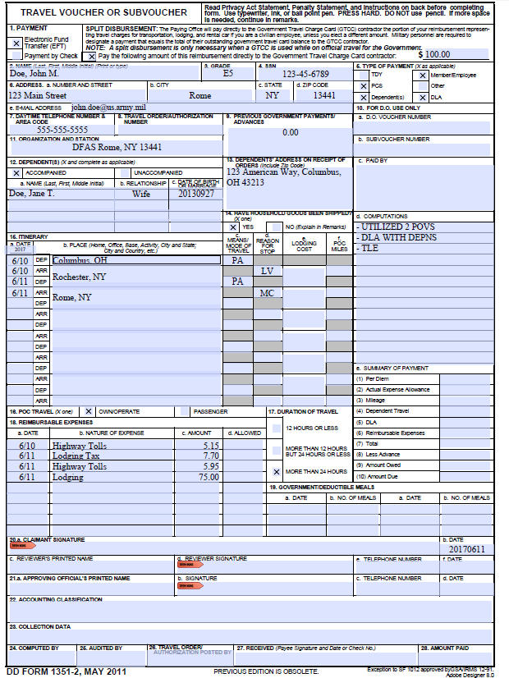
COMPLETING 1351-2
Select “EFT”.
Amount you want paid to your GTCC.
Address at new PDS.
What is the travel claim for?
Depns who traveled and listed in orders.
Depns address prior to the PCS move
What travel entitlements or information you want Disbursing to know.
Itinerary must begin with old PDS and end with new PDS. If depns traveled on different dates or from different locations, include separate itinerary.
Expenses you want reimbursed.
Sign and date. Do not date until you complete travel.

Slide 18
USEFUL INFORMATION
What documents will be needed upon submission of travel claim?
Travel Voucher (1351-2)
All reporting and detaching orders and endorsements from each PDS, TD , and/or PTAD sites.
Port call (for OCONUS travel)
All receipts for commercial transportation or expenses $75.00 or more.
TLE Worksheet with statement of non-availability (if applicable)
DLA Worksheet (if applicable)
When can I expect payment?
Disbursing has up to 10 business days from the date your travel claim was submitted by IPAC to process claim. If any discrepancies are found with your travel claim, it will be returned to IPAC which will restart the submission process.
Final payments are deposited into your existing direct deposit account.
How will I be notified if my travel claim has discrepancies?
IPAC will directly notify you if discrepancies are found. Your admin unit should be your direct point of contact. Do not contact Disbursing personnel unless directly contacted.
Who do I contact if I completed a DITY move?
MCLC Albany, Georgia (229) 639-6575

Slide 19
REFERENCES / POINTS OF CONTACT
The Joint Travel Regulations (JTR)
http://www.defensetravel.dod.mil/Docs/perdiem/JTR.pdf
Marine Corps Travel Instruction Manual (MCTIM)
www.manpower.usmc.mil
Marine Corps Passenger Transportation Program Guide (MCO 4600.7)
For Per Diem Rates: https://www.defensetravel.dod.mil/site/perdiemCalc.cfm
In order to book government lodging:
http://marines.dodlodging.net/
http://www.innsofthecorps.com/index.html
http://www.usmc-mccs.org/MCCS/index.cfm/locations/
Camp Pendleton Disbursing Office Website/ Phone
www.1stmlg.marines.mil/Staff-Sections/Special-Staff/Disbursing/Travel/
(760) 763-7100

Slide 20
QUESTIONS?

