Slide 1
REGIONAL DISBURSING OFFICE – WEST
RETIREMENT TRAVEL BRIEF

Slide 2
CURRICULUM OVERVIEW
Common Separation Terms
Separation Category / Retirement Eligibility
Travel Entitlements
Modes of Travel
Documents Required Upon Submission
Travel Claim Submission
Useful Information
References / Points of Contact

Slide 3
SEPARATION TERMS
Retirement. Completed 20 years of active service/satisfactory years or approved for early retirement.
HOR. Home of Record.
PLEAD. Place entered Active Duty / MEPS. Officers PLEAD will be where mbr attains military status or enters service (i.e. Naval Academy or TBS)
Home of Selection (HOS). Any place within 48 continental states. OCONUS destination must be authorized by HQMC prior to departure. (will be limited to the maximum CONUS allowance unless original HOR)

Slide 4
SEPARATION CATEGORY / RETIREMENT ELIGIBILITY
Separation Category (III).
Retired
Transferred to the Fleet Marine Corps Reserve (FMCR)
Placed on the TDRL/PDRL
Retirement Eligibility.
Commissioned Officers: 20 yrs and 1 day of active service (10 yrs as active commissioned service)
Chief Warrant Officers: 20 yrs of active service
Enlisted: 20 yrs active service or active constructive service

Slide 5
TRAVEL ENTITLEMENTS
What is Per Diem?
Daily amount paid to a traveler on official business which covers lodging, meals, and incidentals.
Commercial transportation per diem is based on the locality rate.
POV per diem is $144 per travel day. (changes every FY)
What is MALT (Monetary Allowance in Lieu of Transportation) ?
Amount paid to traveler to reimburse mbr for mileage used during travel.
Current MALT rate: $0.17 per mile (changes every CY)
Distance is calculated by DTOD (Defense Table of Official Distances)
MALT can be paid up to (2) POVS if mbr states (2) POVs were utilized on 1351-2.
MALT is not based on the number of travelers.
How is travel time/distance calculated?
Travel days are calculated by using (350) miles / per (1) day based on the DTOD distance from old PDS to new PDS.
If the excess distance is (51) miles or more after dividing distance by (350), (1) additional travel day is allowed.
There is no mandatory distance that must be driven per day.

Slide 6
REIMBURSABLE EXPENSES
What expenses are reimbursable?
Tolls
Commercial transportation expenses (bus, airfare, taxi)
Receipts for any expense costing $75.00 or more must be provided
All expenses MUST be annotated on 1351-2 in block 18
What expenses are not reimbursable?
Food
Gas
Any expense $75.00 or more without a valid receipt
What are the requirements for receipts?
Legibly written/printed
Name of vendor
Date the good/service was provided/purchased
Price of the good/service purchased
Total amount due
Indication that the total amount due was paid
Include bank statement showing expense was purchased to prevent issues

Slide 7
MODES OF TRAVEL (POV)
What modes of travel can be used?
Depending on what is authorized in the mbrs orders, a mbr may elect to travel by:
- Personally owned vehicle (POV)
- Commercial transportation (ex: air, bus, rail)
- Transportation purchased by the government
What should a mbr expect when traveling by POV?
Mbr will receive $0.17 per mile traveled.
Travelers will be reimbursed travel per diem for each authorized travel day used which covers the cost of daily lodging and meals.
Mbr: $144.00
Depns 12 and over: $108.00
Depns 11 and under: $72.00
If depns travel on separate dates, the spouse or (1) depn driver will receive the full rate of $144.00
What if I am authorized (8) travel days from PDS to new address, but complete travel in (4) days?
Travelers will be limited to actual travel days utilized meaning DTOD determined travel distance from the (2) locations is over 2,501 miles which allowed (8) travel days. If mbr completes travel in (4) days, all travelers will only receive (4) days of travel per diem plus $447.44 for MALT.

Slide 8
MODES OF TRAVEL (COMMERICAL)
What should a mbr expect when traveling by commercial transportation?
Mbr will receive (1) day of commercial per diem regardless of how many travel days used.
Mbr may be reimbursed airfare if claimed on 1351-2 and provides a valid receipt.
Mbr will be limited to the GTR cost of the flight meaning if mbr purchased flight for $900, but the government could have purchased the flight for $750 then mbr will only receive $750.
To compare GTR costs visit:
https://cpsearch.fas.gsa.gov/cpsearch/search.do?method=enter
What should a mbr expect when traveling by transportation purchased by the government?
Mbr may receive up to (2) days of commercial per diem depending on how many travel days mbr used.
Mbr will not be reimbursed airfare.
Where do I find the rates for commercial per diem?
https://www.defensetravel.dod.mil/site/perdiemCalc.cfm
You will only receive 75% of commercial per diem on the day of departure from PDS and the day of arrival to new address.

Slide 9
MODES OF TRAVEL (MIXED)
What if I use more than one mode of travel?
Using more than one mode of travel from one PDS to the other is known as mixed modes. If authorized in orders, you can travel to your new address by more than one mode (normally POV and commercial air).
How will my travel reimbursement be calculated?
Total reimbursement for POV and commercial travel cannot be more than the total cost of MALT which is the amount the mbr would have received if used their POV only.
The comparison will be (actual travel completed -vs- MALT); ultimately paying the cheapest route.
How would my travel time be calculated if I used mix modes?
Travel time will be calculated by:
Travel days authorized for total distance traveled by POV (350 miles = 1 day)
+
day of commercial per diem
Authorized travel time cannot exceed the time authorized if the mbr would have strictly used their POV.
Refer to JTR, Ch 5: Permanent Duty Travel, Part A: Mbrs Only / Sec 2a. Mbr Travel and Transportation

Slide 10
ADVANCES / DOCUMENTS REQUIRED
Travel Advances. As of 1 Jan 2017, travel advances for separation/retirement travel are no longer available unless granted an exception by CO (Battalion/Squadron level).
Members Approved for Separations Advance. (MALT only / No Per Diem)
Mbr/depns authorized advance for transportation mode intended to use.
Mbr may travel from place of separation to a home of selection. Travel to home of selection is based on actual travel performed and permanent residence established.
Documents Required for Travel Advance.
The written exception
NAVMC 11115
Retirement Orders
Documents Required for Settlement.
Retirement Orders
NAVMC 11060
DD 1351-2
Commercial transportation receipt equal or greater than $75.00

Slide 11
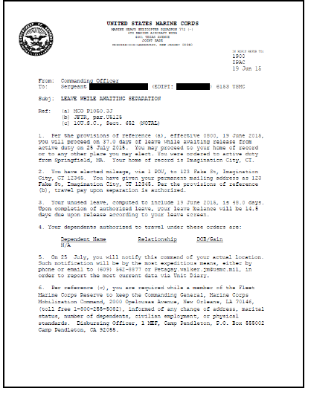
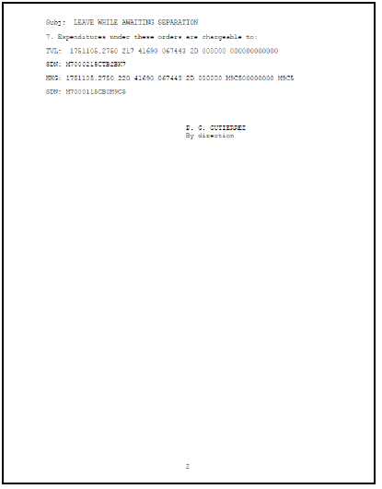
LEAVE WHILE AWAITING SEPARATION ORDERS
Ensure dates are correct. Depns cannot relocate prior to date of orders unless authorized via command letter.
Depns must be authorized in orders in order for travel reimbursement.

Slide 12
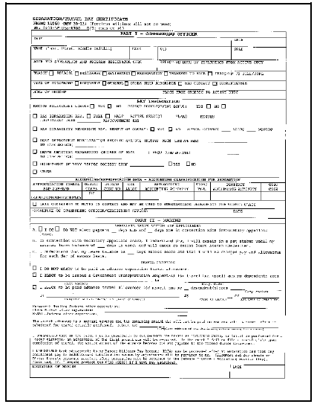
NAVMC 11060 (SEPARATION/TRAVEL PAY CERT)

Slide 13
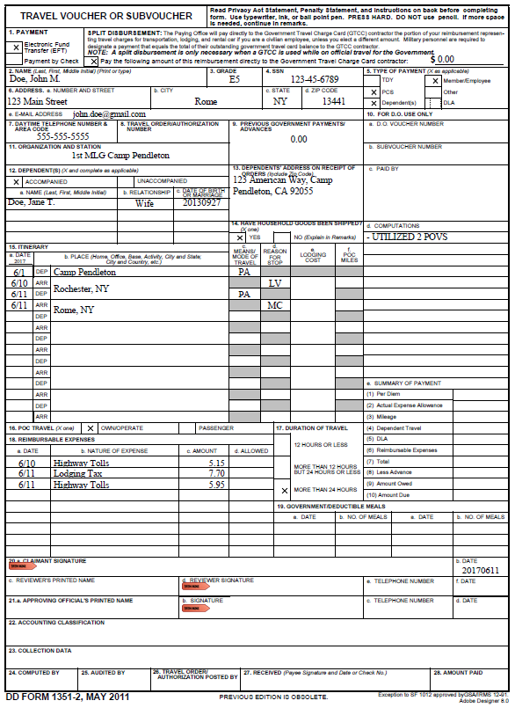
Amount should be $0.00. GTCC not authorized upon sep /retirement.
Select “EFT”.
New address after separation
What is the travel claim for?
Depns who traveled and listed in orders.
Valid POC info
Advances (if any)
Depns address prior to the separation
What travel entitlements or information you want Disbursing to know.
Means/Mode of Travel.
Commercial Auto (cab) : CA
Transportation Provided (at no cost) : TP
Commercial Air (self purchased): CP
Private Auto : PA
Reason For Stop.
Awaiting Transportation : AT
Leave: LV
Mission Complete : MC
Itinerary must begin with old PDS and end with new address after separation. Must be same address listed in block 6. If depns traveled on different dates or from different locations, include separate itinerary.
Expenses you want reimbursed.
Sign and date. Do not date until you complete travel.

Slide 14
USEFUL INFORMATION
Mbr must complete travel before a travel claim can be paid.
Mbr must complete travel NLT 1 year after ECC.
If mbr received an advance and failed to submit a travel claim, the DO/FO will begin collection action 30 days after ECC. The debt will then be turned over to DFAS for collection from retired pay.
You will no longer need to contact IPAC regarding your travel claim. Disbursing will be your direct contact.
Ensure you provide a valid email and number on your 1351-2 in case there are discrepancies with your travel claim.
Upon submission of your travel claim via email, you will receive a confirmation email stating your claim was received.

Slide 15
USEFUL INFORMATION
Disbursing/Finance office will process claims within 10 business days from the date voucher was submitted, but cannot be paid prior to mbrs end of active service (EAS).
Disbursing/Finance office will not pay a separations travel advance any earlier than 10 days prior to estimated travel begin date.
Upon final settlement, per diem is based on actual travel time used, not to exceed maximum travel time authorized.
Do not include gas, lodging, or food receipts.
Temporary Lodging Expenses (TLE) and Dislocation Allowance (DLA) are not authorized upon separation.
If you did a Do-It-Yourself (DITY) Move, ensure you send a DITY Move claim to MCLC Albany, GA based on the instructions you were provided by the DMO office. Instructions, forms and contact information can be obtained from their website: http://www.logcom.marines.mil/Capabilities/DITYMoves.aspx

Slide 16
TRAVEL CLAIM SUBMISSION
Travel Claim Submission. Travelers may submit via email or mail.
Email: 1MEF_Disbursing_Travel@usmc.mil
Mail: Disbursing Officer
Attn: Disbursing Travel
Box 555607
Camp Pendleton, CA 92055
Questions. Please wait 10 business days after submission before contacting Disbursing.
Phone: 760-763-7100, Ext. 1
Final Payments.
Final payments are deposited into mbrs existing direct deposit account.
Alternate accounts. complete the Alternate EFT Account Election Form provided to your Separations section personnel or update via MyPay.
Do not close your direct deposit account until payment has been posted.

Slide 17
REFERENCES / POINTS OF CONTACT
Joint Travel Regulations (JTR)
http://www.defensetravel.dod.mil/Docs/perdiem/JTR.pdf
Marine Corps Travel Instruction Manual and Travel Advisory Notice (MCTIM/TANs)
www.manpower.usmc.mil
Camp Pendleton Disbursing Office
760-763-7100 / 1MEF_Disbursing_Travel@usmc.mil

Slide 18
QUESTIONS?

